Slide 1
WALS Fees: DeMystified!
Aug 31st, 2021

Slide 2
WALS Fees: The Why What does my library get for my money?
Library-specific, shared automation services (aka “ILS”).
Hardware and ongoing software costs to SirsiDynix and other venders for primary library software (SirsiDynix Symphony, Syndetics Unbound content enhancement, Shoutbomb SMS notices, OCLC for catalog records).
Payment to Oshkosh to maintain the database so records are correct and people can easily find what they are looking for.
Shared catalog for patrons to find and obtain materials at all other 29 WALS libraries.
Notifications to patrons that their holds are in and items will soon be due (or overdue).

Slide 3
WALS Fees: The Why What does my library get for my money?
Shared Network Access:
Internet access and equipment.
WiscNet & Charter costs for telecommunication infrastructure and yourlibrary.org identity.
Wireless access in every library.
File sharing, storage and backup.
Remote access software for library support.
Security software, services, and insurance to protect your library’s data.

Slide 4
WALS Fees: The Why What does my library get for my money?
People:
Salaries for 2 FTE automation librarians. They maintain and keep the ILS functioning properly. They setup new products, change settings, provide statistics and maintenance reports for each member library.
A portion of Winnefox IT staff salaries. They maintain and keep your libraries’ PCs and network equipment functioning properly.
Mileage for when any of them need to go to a library for on-site support.

Slide 5
WALS Fees: The Why What does my library get for my money?
Training:
For you and other staff to keep skills current on the ILS
For WALS staff to be able to better support the libraries with current technology
Documentation and tutorials for ILS procedures and best practices

Slide 6
WALS Fees: The Why What does my library get for my money?
Capital Reserve Fund:
Every year we put money aside so when we need to replace something we’ve got the money for it. For example, the router in your library costs somewhere around $1,200 - $1,500. If lightning takes it out tonight we’ll have a new one on the way tomorrow free of charge.

Slide 7
WALS Fees: The Base-ics
The “Base Fee”:
This the minimum amount a library pays to buy into all those services.
$8,300 for 2022
Normally goes up every year.
Stayed flat for 2 years:
2020 because OPL restructured services and reduced costs;
2021 because of COVID.
Is for libraries whose “formula share” would be less than the Base Fee amount.

Slide 8
The Data:
Fees based on “File Size” and Circulation
Used by many library consortia, vendors
Acts as a proxy for a library’s use of the system
Is a snapshot of the system taken when the budgeting process begins in June.
Gets averaged together so that Library Average Percentage is slightly more stable if circulation fluctuates radically.
This year we took the average of the past 3 years’ File Size and Circulation to smooth out the drop in Circulation due to COVID.

Slide 9
The Data: File Size
User Records
All Patrons—active or not
All Logins –WD-OX, MO-STAFF
All Test, Library Use, Dummy, Bookclub cards
Item Records
All Items—regardless of status
Includes Sales Items
Includes Events Items

Slide 10
The Data: Circulation
All Checkout and Renew transactions
To Patrons—including book clubs, day cares, nursing homes, home bound.
To Staff.
To special “users” like: Missing, Damaged, In-Process, Withdrawn. System-wide these make up about 7.5%
Normally looks at snapshot of checkouts & renews In the last 365 days from the date of the snapshot (usually taken mid-June).
Notes:
Normally we use 365 days to ensure data reflects current activity. This year, I pulled the old snapshots from May 2019 & June 2020, and ran a new snap in June 2021 and took the average of the 3 years.
The publicly available Annual Report numbers from DPI are at best 18 months old, at worst 40 months old. They never have the most current year published by budget time.
FYI, the numbers on the following charts aren’t exact—but are very very close. I couldn’t get Analytics to do 365 days at a time easily, so had to use calendar years.

Slide 11
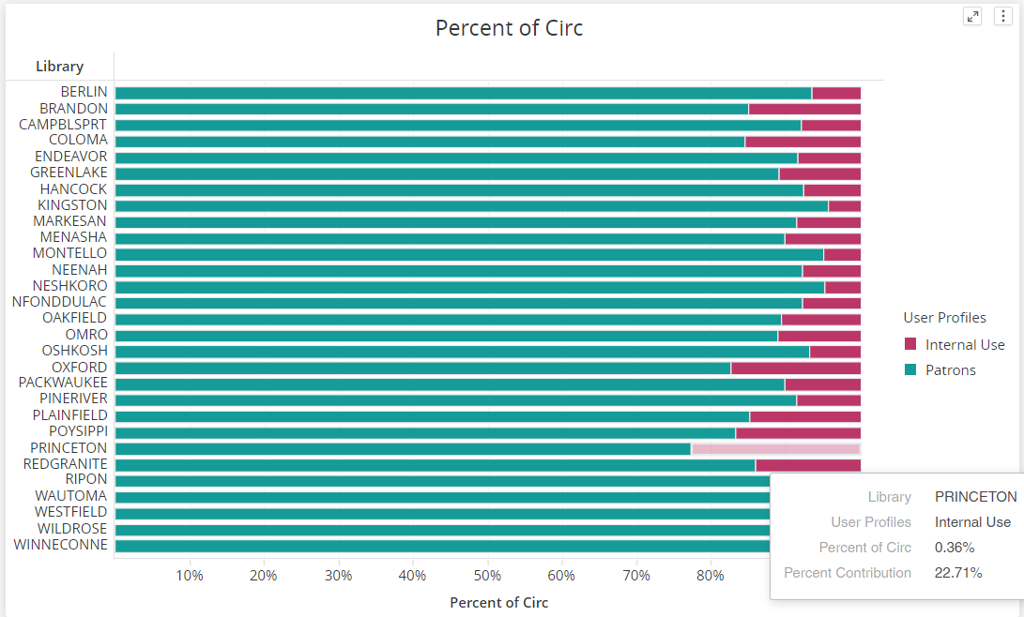
The Data: Circulation
Notes:
The red is internal “Special” users, the teal is real Patrons. Quite clearly, majority of circ is to real patrons. But look at Princeton! Largest % of internal users compared to everyone else. You know why? Because in 2019 they had a building project. In 2020 their circ to regular patrons went down because of COVID, but they also opened their new building so circ was up.

Slide 12
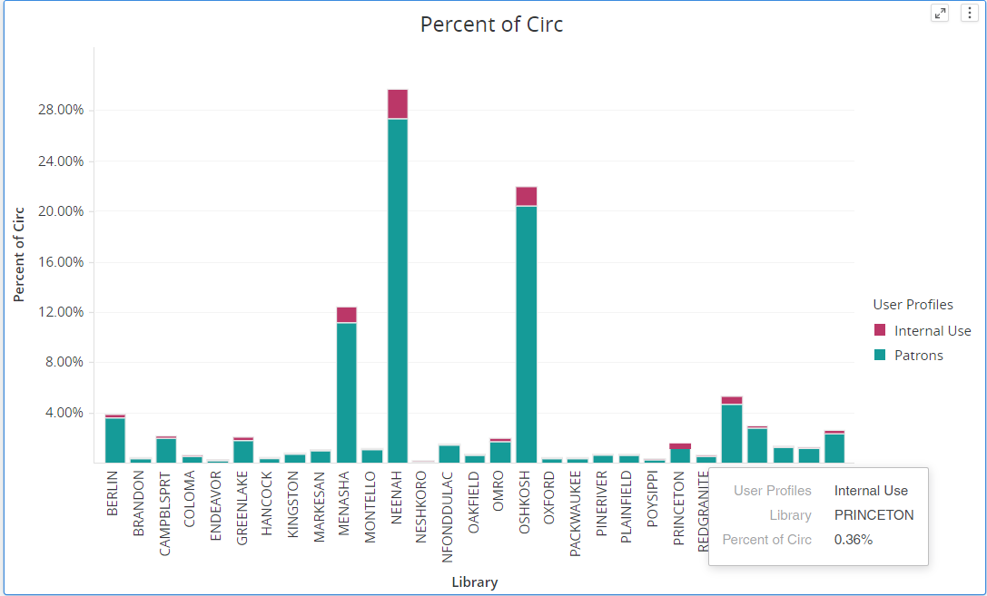
The Data: Circulation
Notes:
So, even tho’ almost 23% of Princeton circ went to these “special” internal users, that only accounts for 0.36% of the total circ across the system.

Slide 13
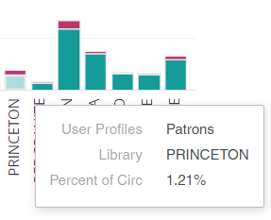
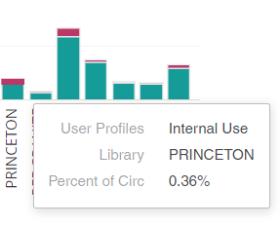
The Data: Circulation
Notes:
So, you can see, in total Princeton only accounts for 1.57% of total circ. MY POINT HERE IS: these numbers are indicators of how busy your library is compared to everyone else. AND the Internal Use numbers are not a major factor—altho they do have a little impact.

Slide 14
Library Percentage
Two small pies—File Size and Circulation--get averaged together into 1 big pie.
Each library’s slice varies based on their own activity AND the size of other libraries’ slices.
If library A’s Circ goes way up or way down, everyone else’s percent of circulation will shift slightly to adjust.
If library B’s File Size goes way up or way down, that will either offset or enhance the adjustment from Library A’s change.
That is why we used a 3-yr average this year.
Initial percentage is calculated for ALL libraries.

Slide 15
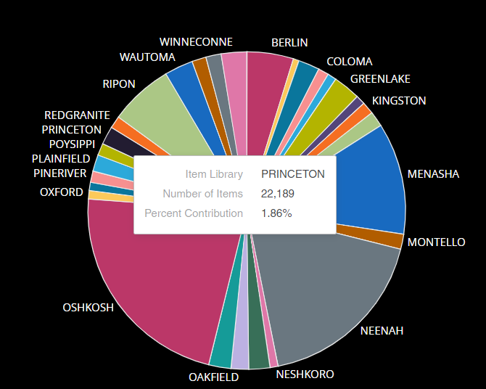
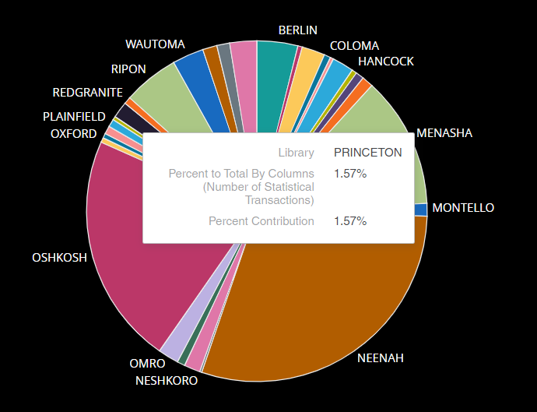
Library Average Percentage
% of File Size
% of Circulation

Slide 16
Library Average Percentage
File Size
File Size Total = 1,386,914
Circulation
Circulation Total = 2,308,209
Library A’s File Size = 10,000
Library A’s FS % = (10,000 ÷ 1,386,914) X 100 = 0.72%
Library A’s Circulation = 20,000
Library A’s Circ % = (20,000 ÷ 2,308,209) X 100 = 0.87%
Library A’s Ave % =
(0.72% + 0.87%) ÷ 2 =
0.80%
Calculation

Slide 17
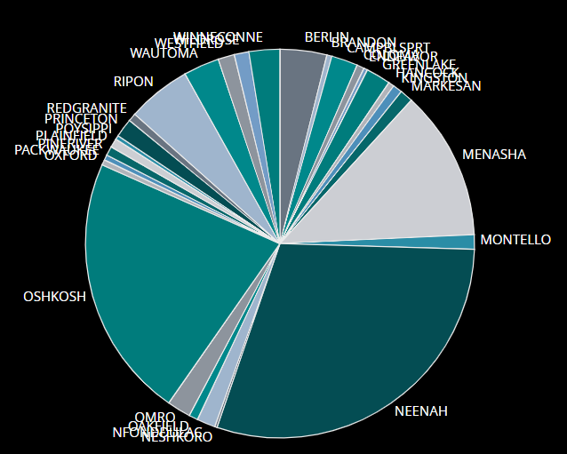
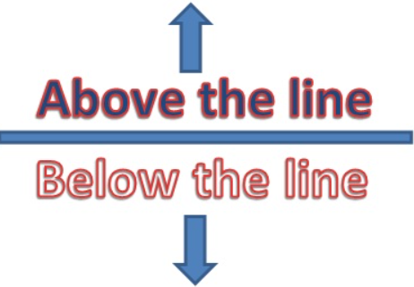
The Fee Calculation: Who’s at Base?
> $8300
< $8300
Revenue Needed
All Libraries’ Library Ave %
Determine which libraries are below Base amount
$740,000
Library A’s Fee = $740,000 X 0.80% = $5,874
Library A is a Base Library and fee becomes $8,300

Slide 18
The Fee Calculation: What’s Left?
Revenue Needed
Base Libraries
Amount to share with Above-Base Libraries
Pretend we have 10
10 X $8300 = $83,000
$730,000 - $83,000 = $647,000
$730,000

Slide 19
The Calculation: Above-Base Libraries
Amount to share with Above-Base Libraries
Above Base Fees
Pretend Oshkosh’s average is 25%
$647,000 X .25 = $161,750
Oshkosh’s fee is $161,750
$647,000

Slide 20
Questions: ??????????

